Slide 1
Summary of Multi-Label Learning
Presentation: Ning Chen Supervisor: Shen-Huan Lyu
Date: 23/1/2024

Slide 2
Table of Contents
Introduction
Related Work
Research Trends and Future Research Directions

Slide 3
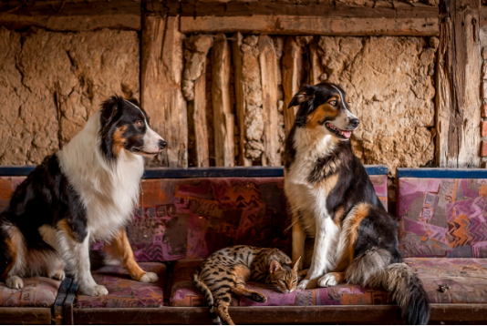
Introduction
What’s the Single-Label Learning?
Fig 1: dog and cat

Slide 4
Introduction
What’s the Multi-Label Learning?
Fig 2: dog and cat

Slide 5
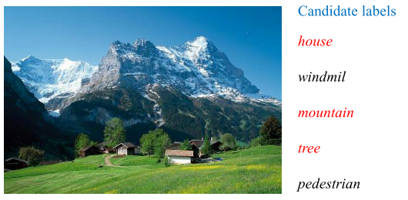
Introduction
What’s the Problem We Encount in Multi-Label Learning?
the cost of label annotation is high.
the annotator maybe not be reliable.
Fig 3: annotator gives the lables of the picture [1]

Slide 6
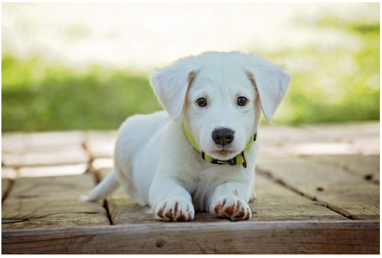
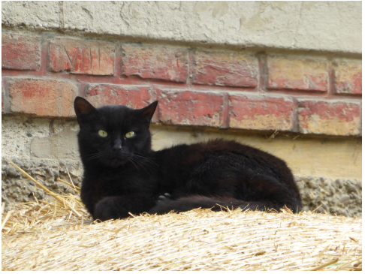
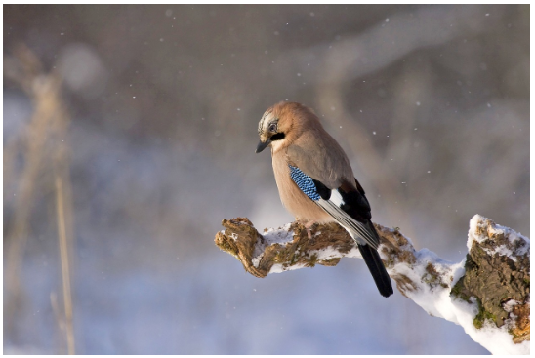
Introduction
What’s the Problem We Encount in Multi-Label Learning?
class labels in the label space typically have imbalanced distributions.
Fig 4: the classification task of dogs、cats and birds

Slide 7
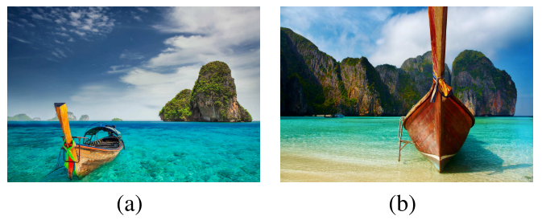
Introduction
What’s the Problem We Encount in Multi-Label Learning?
the labels also have relationships among them, and researchers are studying it.
Fig 5: Two natural scene image examples which are both annotated with the labels water, boat, mountain, and sky. [2]

Slide 8
Related Work
Binary Relevance(BR)
Binary relevance decomposes the multi-label learning task into numerous independent binary learning tasks. This means that for each label, a separate binary classifier is built, without considering the presence of other labels. However, it ignores correlations between labels.
In 2018 years, MoralGarcia, Serafin et al. [3] use CC4.5 as the base classifier have the better performance compared to BR with C4.5, which indicates that imprecise probabilities in Decision Trees within the MLC field appears to be a promising approach. Yuan Lik Xun et al. [4] propose a modified supervised adaptive resonance theory neural network(监督自适应共振理论神经网络), which is integrated with the binary relevance, and this model have a good performance. Wu, Guoqiang et al. [5] propose a unified framework to implement linear BR for multi-label learning, which is easy to extend and can also be applied to one-to-many strategies for multi-class classification.
In 2020 years, Wu, Guoqiang et al. [6] propose a new model that combine Ranking Support Vector Machine and Binary Revelance with robust Low-rank Learinging. Wever, Marcel et al. [7] focuses on selecting the best base learner to handle binary classification problems and proposes a method based on the label independence assumption, called LiBRe.
In 2023 years, Kumar, Sanjay et al. [8] use binary relevance to solve the question of movie classification.

Slide 9
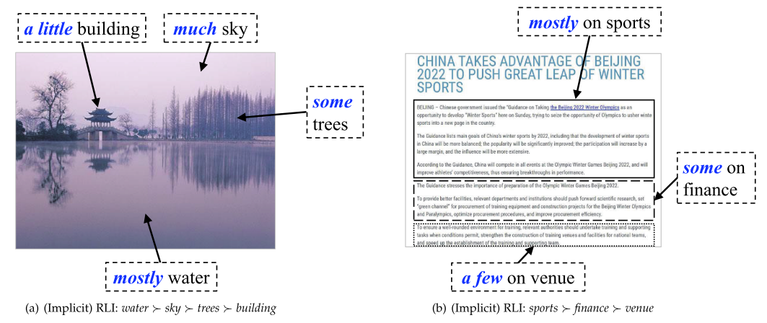
Related Work
Study on Correlations Between Labels.
How to understand the correlations between labels?
Fig 6: an example of correlations between labels [9]

Slide 10
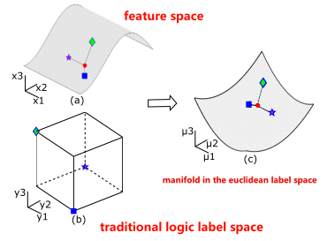
Related Work
Study on Correlations Between Labels.
In 2015 years, Min-Ling Zhang et al. [9] use implicit relative labeling-importance information to get a good performance in multi-label learning.
In 2016 years, Peng Hou et al. [10] try to expore the manifold in the label space for multi-label learning.
Fig 7: Transformation of the local topological structure from the feature space to the label space. [10]

Slide 11

Related Work
Study on Correlations Between Labels.
In 2018 years, Ruifeng Shao et al. [11] propose a novel multi-label learning framework Label Enhanced Multi-Label Learning, which incorporates regression of the numerical labels and label enhancement into a unified framework. We assume Fig. 8 with five possible labels sky, desert, tree, camel and fish, the logical label vector will be [+1, +1, +1, -1, -1]^{T} , but numerical label can be [2, 3, 1, 0, -1]^{T} , which reflects the importance of labels.
Fig. 8: An exemplar natural scene image which has been annotated with multiple labels sky, desert and tree. [11]

Slide 12
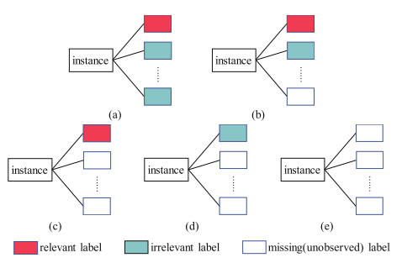
Related Work
Study on Correlations Between Labels.
In 2019 years, Jia-Qi Lv et al. [12] propose a new method named Weakly Supervised Multi-label Learning via Label Enhancement to solve the condition of missing labels in the training set.
Fig. 9: The data setting of weakly supervised multi-label learning. [12]

Slide 13
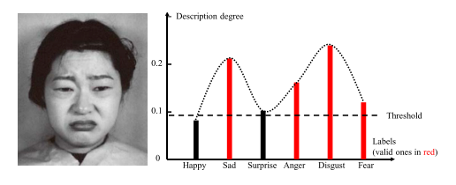
Related Work
Study on Correlations Between Labels.
In 2020 years, Ning Xu et al. [1] propose a new method named Partial Multi-label Learning with Label Distribution to learn from training examples each associated with a set of candidate labels, among which only a subset are valid for the training example
Fig. 10: An example about the differentiation between candidate labels and non-candidate labels in PML. [1]

Slide 14

Related Work
Study on Correlations Between Labels.
In 2022 years, Ning Xu et al. [13] propose a novel Probabilistic Label Enhancement Algorithm, called PLEA, to solve challenging label distribution learning(LDL) for multi-label classification problems and adopt the well-known maximum entropy model based label distribution learner. However, unlike the existing LDL algorithms based on the maximum entropy model, they propose to use manifold learning to enhance the label distribution learner.
In 2023 years, Ke Zhu et al. [14] argued that scene image self-supervised learning does not necessarily rely on dense matching or unsupervised object discovery methods. The author adopt MoCo-V2 as their base structure and use the binary cross entropy(BCE) loss to optimize the pseudo labels and the classified logits interact with each other.
Fig. 11: BCE loss and which τ is a temperature hyperparameter (following MoCo-v2’s), and σ(·) is the sigmoid function that maps the scores to the range [0, 1]. [14]
In 2023 years, Ning Xu et al. [15] propose a novel partial multi-label learning method to recover the latent label distribution and progressively enhance it for predictive model induction.

Slide 15
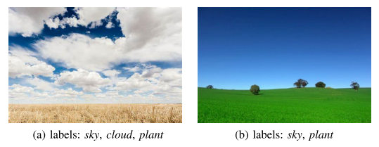
Related Work
Study on Correlations Between Labels.
In 2023 years, Xingyu Zhao et al. [16] propose a novel MLC learning method named Scalable Label Distribution Learning (SLDL) for multi-label classification which can describe different labels as distributions in a latent space, where the label correlation is asymmetric and the dimension is independent of the number of labels.
Fig. 12: An illustration of exemplar images and their corresponding labels. [16]

Slide 16
Research Trends and Future Research Directions
Multimodal data multi-label classification
Imbalanced data distribution for multi-label classification
Prompt-based learning for multi-label classification

Slide 17
References
[1] Xu N, Liu Y P, Geng X. Partial multi-label learning with label distribution[C]. Proceedings of the AAAI conference on artificial intelligence. 2020, 34(04): 6510-6517.
[2] Hou P, Geng X, Zhang M L. Multi-label manifold learning[C]. Proceedings of the AAAI conference on artificial intelligence. 2016, 30(1).
[3] Moral-García S, Mantas C J, Castellano J G, et al. Using credal-C4. 5 with binary relevance for multi-label classification[J]. Journal of Intelligent & Fuzzy Systems, 2018, 35(6): 6501-6512.
[4] Yuan L X, Tan S C, Goh P Y, et al. Fuzzy ARTMAP with binary relevance for multi-label classification[C]. Intelligent Decision Technologies 2017: Proceedings of the 9th KES International Conference on Intelligent Decision Technologies (KES-IDT 2017)–Part II 9. Springer International Publishing, 2018: 127-135.
[5] Wu G, Tian Y, Zhang C. A unified framework implementing linear binary relevance for multi-label learning[J]. Neurocomputing, 2018, 289: 86-100.
[6] Wu G, Zheng R, Tian Y, et al. Joint ranking SVM and binary relevance with robust low-rank learning for multi-label classification[J]. Neural Networks, 2020, 122: 24-39.
[7] Wever M, Tornede A, Mohr F, et al. Libre: Label-wise selection of base learners in binary relevance for multi-label classification[C]. Advances in Intelligent Data Analysis XVIII: 18th International Symposium on Intelligent Data Analysis, IDA 2020, Konstanz, Germany, April 27–29, 2020, Proceedings 18. Springer International Publishing, 2020: 561-573.
[8] Kumar S, Kumar N, Dev A, et al. Movie genre classification using binary relevance, label powerset, and machine learning classifiers[J]. Multimedia Tools and Applications, 2023, 82(1): 945-968.
[9] Li Y K, Zhang M L, Geng X. Leveraging implicit relative labeling-importance information for effective multi-label learning[C]. 2015 IEEE International Conference on Data Mining. IEEE, 2015: 251-260.

Slide 18
References
[10] Hou P, Geng X, Zhang M L. Multi-label manifold learning[C]. Proceedings of the AAAI conference on artificial intelligence. 2016, 30(1).
[11] Shao R, Xu N, Geng X. Multi-label learning with label enhancement[C]. 2018 IEEE international conference on data mining (ICDM). IEEE, 2018: 437-446.
[12] Lv J, Xu N, Zheng R Y, et al. Weakly Supervised Multi-Label Learning via Label Enhancement[C]. IJCAI. 2019: 3101-3107.
[13] Tan C, Chen S, Ji G, et al. A novel probabilistic label enhancement algorithm for multi-label distribution learning[J]. IEEE Transactions on Knowledge and Data Engineering, 2021, 34(11): 5098-5113.
[14] Zhu K, Fu M, Wu J. Multi-Label Self-Supervised Learning with Scene Images[C]. Proceedings of the IEEE/CVF International Conference on Computer Vision. 2023: 6694-6703.
[15] Xu N, Liu Y P, Zhang Y, et al. Progressive enhancement of label distributions for partial multilabel learning[J]. IEEE Transactions on Neural Networks and Learning Systems, 2021.
[16] Zhao, X., An, Y., Qi, L., & Geng, X. Scalable Label Distribution Learning for Multi-Label Classification. ArXiv. /abs/2311.16556

Slide 19
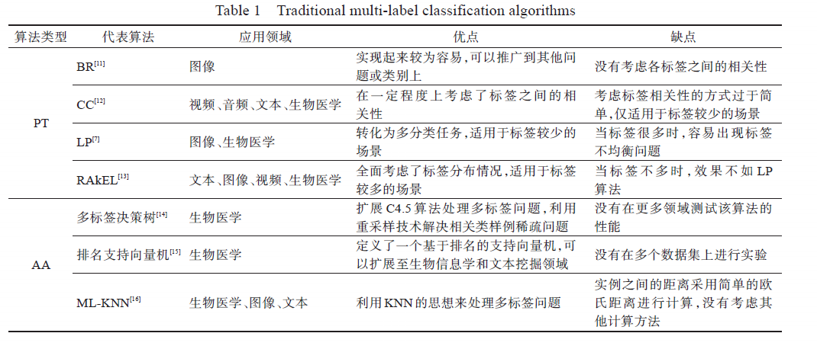
problem transformation(PT)：The essence is to simply convert multi-label classification problems into multiple single-label classification problems.
algorithm adaptation(AA): The core idea is to directly process multi-label classification problems by modifying existing suitable algorithms
李冬梅, 杨宇, 孟湘皓, 张小平, 宋潮, 赵玉凤. 多标签分类综述[J]. 计算机科学与探索, 2023, 17(11): 2529-2542.

Slide 20
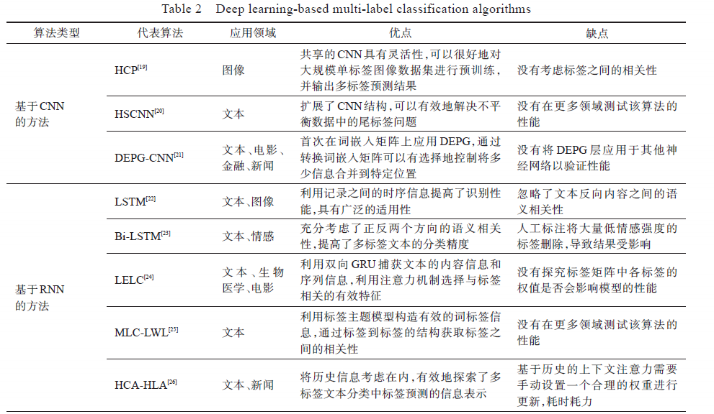

Slide 21
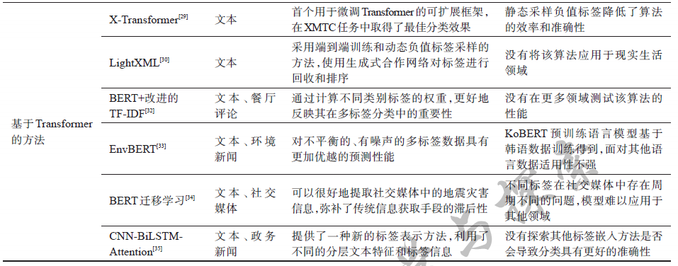
李冬梅, 杨宇, 孟湘皓, 张小平, 宋潮, 赵玉凤. 多标签分类综述[J]. 计算机科学与探索, 2023, 17(11): 2529-2542.

Slide 22
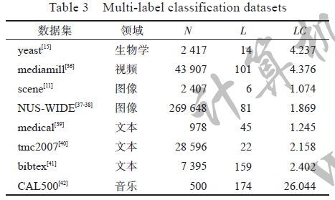
李冬梅, 杨宇, 孟湘皓, 张小平, 宋潮, 赵玉凤. 多标签分类综述[J]. 计算机科学与探索, 2023, 17(11): 2529-2542.

Slide 23
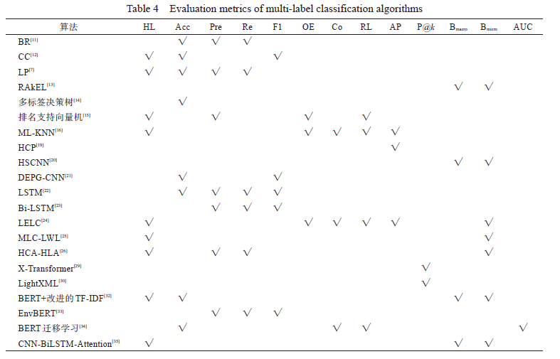
李冬梅, 杨宇, 孟湘皓, 张小平, 宋潮, 赵玉凤. 多标签分类综述[J]. 计算机科学与探索, 2023, 17(11): 2529-2542.

